Slide 1
weather monitoring system

Slide 2
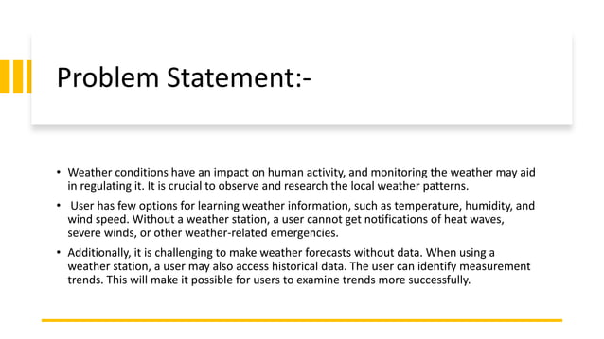

Slide 3
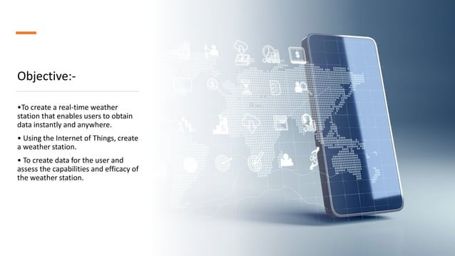

Slide 4
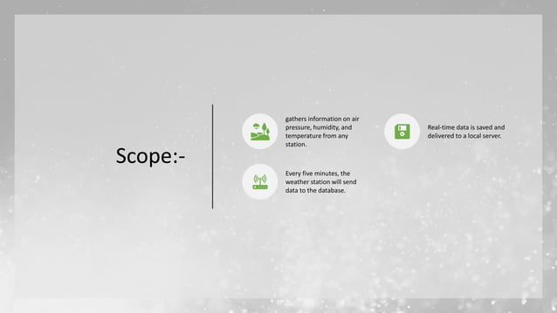

Slide 5
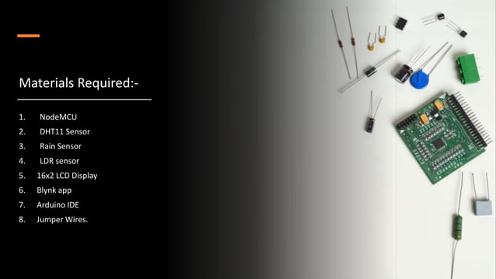

Slide 6
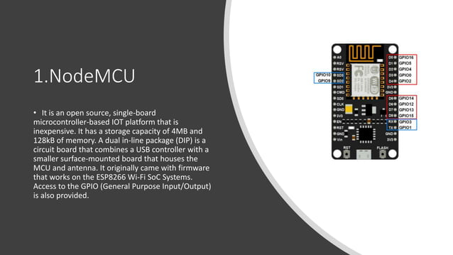

Slide 7
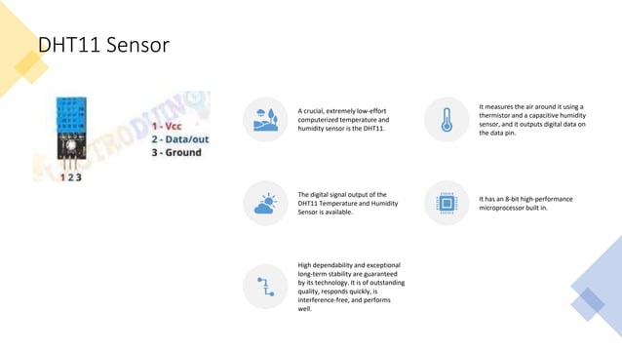

Slide 8
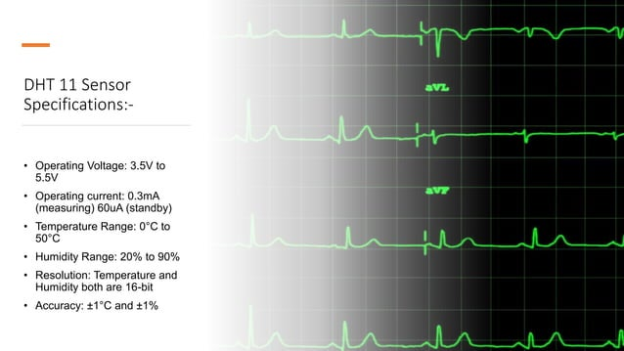

Slide 9
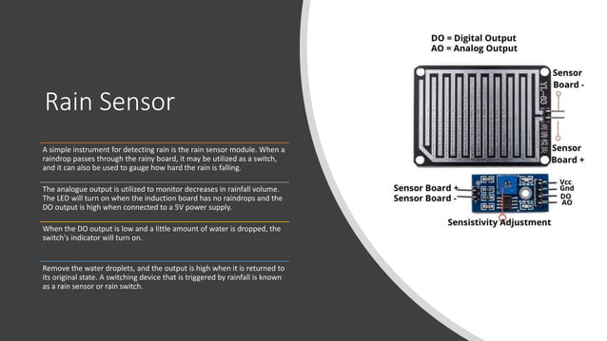

Slide 10
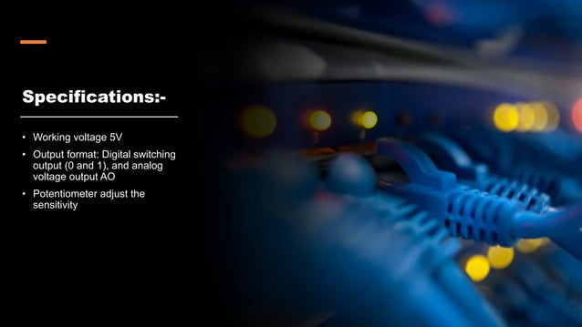

Slide 11
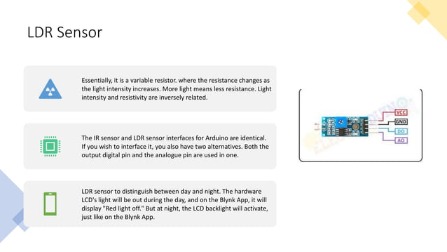

Slide 12
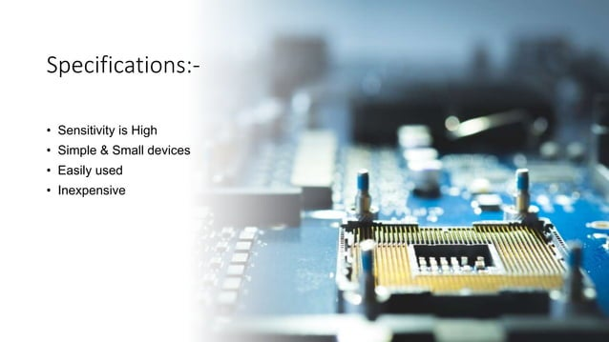

Slide 13
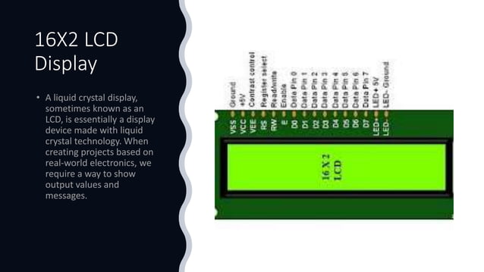

Slide 14
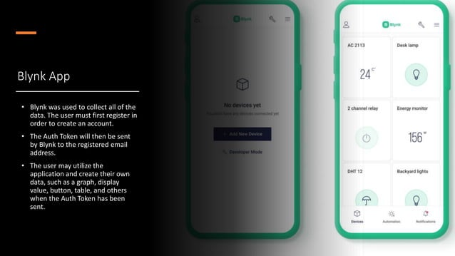

Slide 15
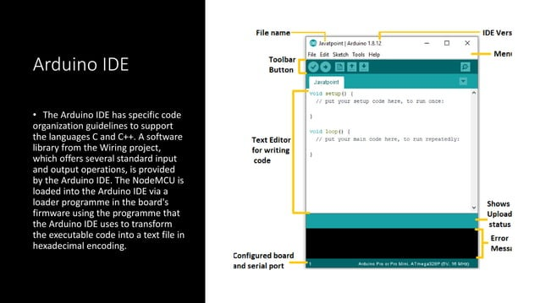

Slide 16
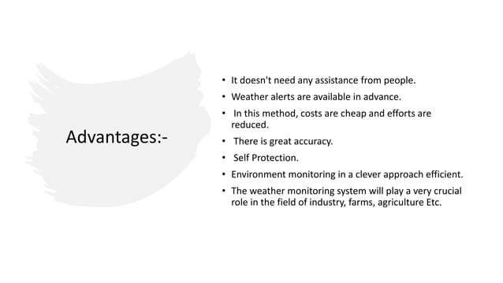

Slide 17
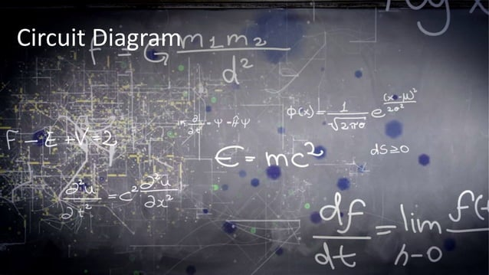

Slide 18
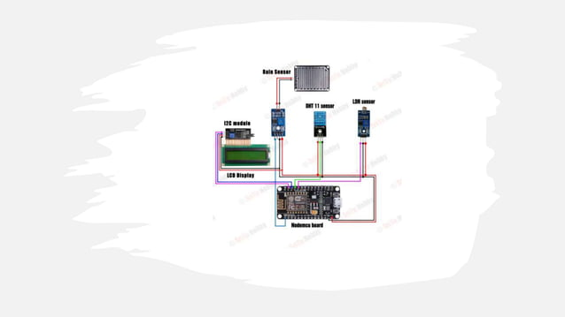

Slide 19
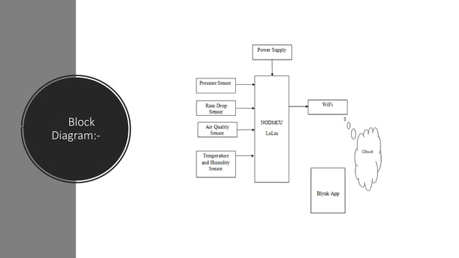

Slide 20
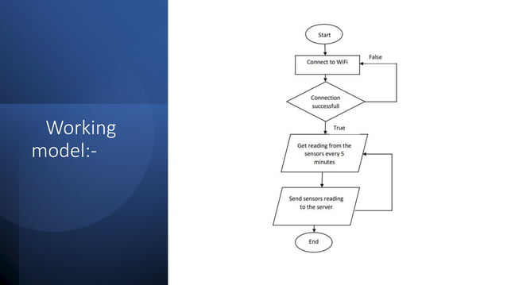

Slide 21
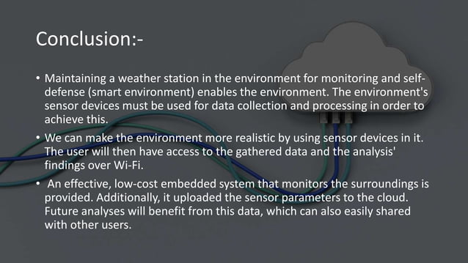

Slide 22
Potential of VR in agriculture
VR can solve these problems in a jiffy if its applications are brought in agriculture. VR is cheaper than most of the current agricultural technologies. Furthermore, it doesn’t need a huge technical know-how of its usage. Its simple user interface and great immersive technology is an additional advantage. Overall, VR in agriculture is promising and could improve its practices manifold.
Let us take a look at some of the applications VR can have in future:
Virtual Crops
VR can help visualise crop patterns into future.Additionally, it could show crop growth based on weather patterns, practices etc. Researchers can collect data, test and observe the crop growth and suggest changes in practices. This will help farmers prepare their crops against any unwelcome environmental changes.
Virtual crop monitoring:
Drones having 360 degree camera can give virtual tours of the crop area. Immersive technology of VR could help farmers monitor the crop. Furthermore they could check damages, keep a tab on the state of crop growth etc.
Equipment check-ups
Some equipment are complex and dangerous to handle. This makes it difficult for regular maintenance and surveying. Hence, VR could help realise the working of the equipment, and to give an immersive view of its condition and smaller components.
Weather forecast
VR can step up the weather forecast by giving weather conditions that could stimulate or stunt the crop growth. With satellite technology and readings, farmers and researchers could forecast droughts or floods alongside their effects on the land.
Checks on livestock
Farmers maintaining livestock over large areas could also benefit from VR. They can keep a check on the health of the livestock, as well as keep a count or see for looming threats. This will benefit a whole different industry in general. Furthermore, VR equipment don’t cost much thus making it more profitable option. There are various other applications which VR could have in agriculture. Agriculture is a huge field, and with increasing potential and development of VR we are going to see a major technological upheaval in the near future.
Notes:
https://www.affinityvr.com/vr-aid-agriculture-in-future/

Slide 23
https://rawe2020.in/wp-content/uploads/2022/10/final-report.pdf
https://www.slideshare.net/RedmondRaminShamshir/digital-agriculture-virtual-reality-agricultural-robotics

